Slide 1

JAN 2021
Modeling of Cascading Failure in Power Systems
Jeehyun park
M.S. Student, The University of Texas at Austin

Slide 2
1. Motivation
Cascading outage simulator
It is designed to set and reproduce scenarios that can occur in the electric grid.
It allow us to study a wide variety of different mechanisms of cascading outages.

Slide 3
2. Proposed Method
“Cascading Outage Simulator with Multi-process Integration Capabilities” (COSMIC)
Hybrid System Modeling in COSMIC
Hybrid differential-algebraic formulation
Relay modeling
Solving the hybrid DAE

Slide 4
3. Hybrid differential-algebraic formulation
In COSMIC, Dynamic power networks are modeled as sets of DAEs.
A set of Differential equations
A set of Algebraic equations
A set of Constraints

Slide 5
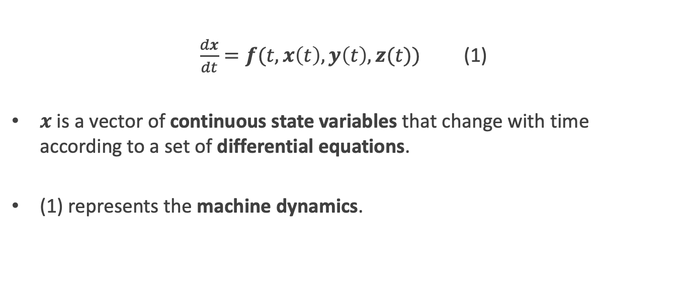
3-i. A set of differential equations
$\frac{dx}{dt}=f(t, x\left(t\right),y\left(t\right),z(t))$ (1)
$x$ is a vector of continuous state variables that change with time according to a set of differential equations.
(1) represents the machine dynamics.

Slide 6
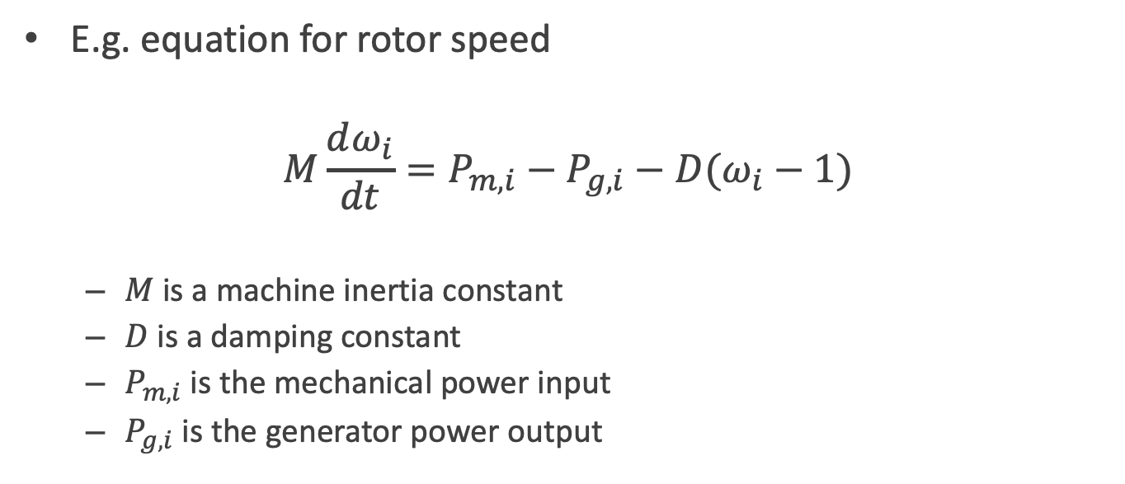
3-i. A set of differential equations
E.g. equation for rotor speed
$$M\frac{dω_{i}}{dt}=P_{m, i}−P_{g, i}−D(ω_{i}−1)$$
$M$ is a machine inertia constant
$D$ is a damping constant
$P_{m, i}$ is the mechanical power input
$P_{g, i}$ is the generator power output

Slide 7
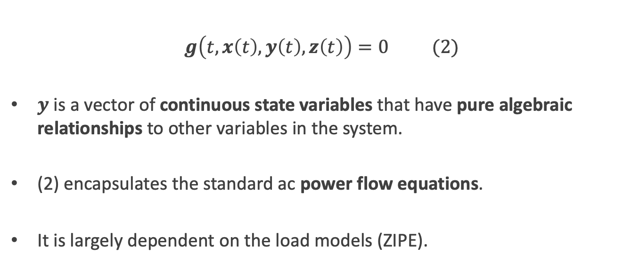
3-ii. A set of algebraic equations
$g\left(t, x\left(t\right),y\left(t\right),z\left(t\right)\right)=0$ (2)
$y$ is a vector of continuous state variables that have pure algebraic relationships to other variables in the system.
(2) encapsulates the standard ac power flow equations.
It is largely dependent on the load models (ZIPE).

Slide 8
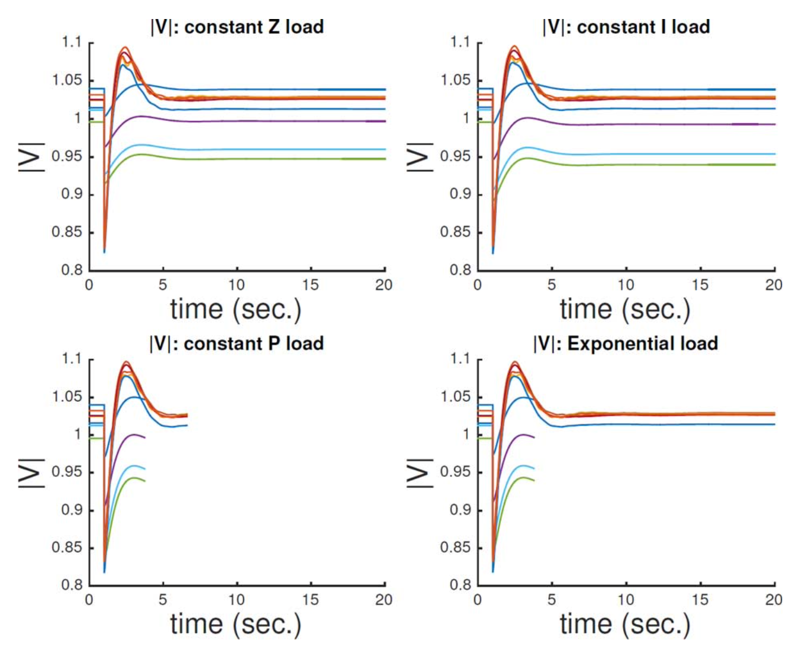
3-ii. A set of algebraic equations
ZIPE models
Notes:
Q. WHAT IS EXPONENTIAL MODEL???

Slide 9
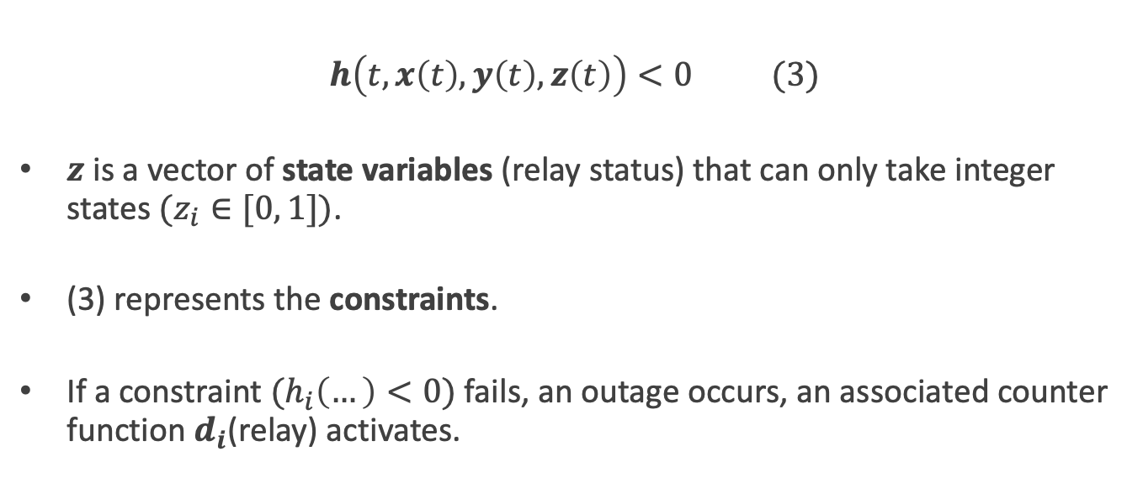
3-iii. A set of constraints
$h\left(t, x\left(t\right),y\left(t\right),z\left(t\right)\right)<0$ (3)
$z$ is a vector of state variables (relay status) that can only take integer states $(z_{i}∈[0, 1])$.
(3) represents the constraints.
If a constraint $(h_{i}\left(…\right)<0)$ fails, an outage occurs, an associated counter function $d_{i}$(relay) activates.

Slide 10
3. Hybrid differential-algebraic formulation
What happens during cascading failures?
The power systems many undergo discrete changes.
The discrete event(s) will consequently change the systems dynamic response and algebraic equations.
The changes may result in cascading failures, system islanding, and large blackouts.

Slide 11
4. Relay modeling
Five types of protective relays are modeled in COSMIC:
Over-current (OC) relays
Distance (DIST) relays
Temperature (TEMP) relays
Under-voltage load shedding (UVLS) relays
Under-frequency load shedding (UFLS)

Slide 12
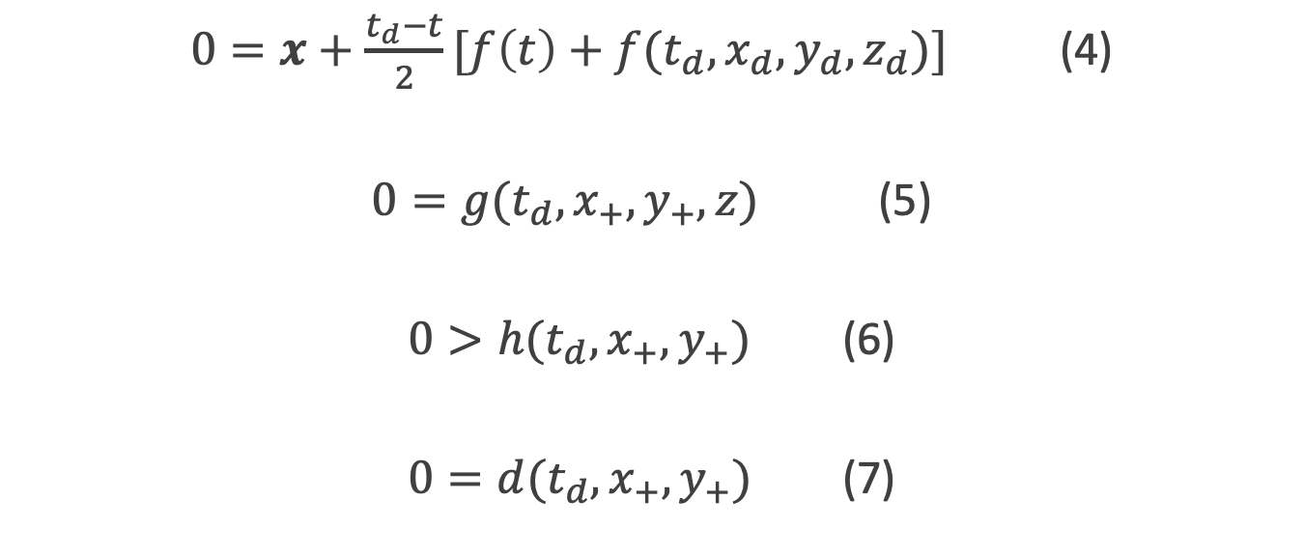
5. Solving the hybrid DAE
$0=x+\frac{t_{d}−t}{2}[f\left(t\right)+f(t_{d},x_{d},y_{d},z_{d})]$ (4)
$0=g(t_{d},x_{+},y_{+},z)$ (5)
$0>h(t_{d},x_{+},y_{+})$ (6)
$0=d(t_{d},x_{+},y_{+})$ (7)
Notes:
Q. HOW TO APPLY TRAPEZOIDAL RULE TO A DISCRETE POINT???
Q. HOW THE LINEAR INTERPOLATION WORKS IN HERE???

Slide 13
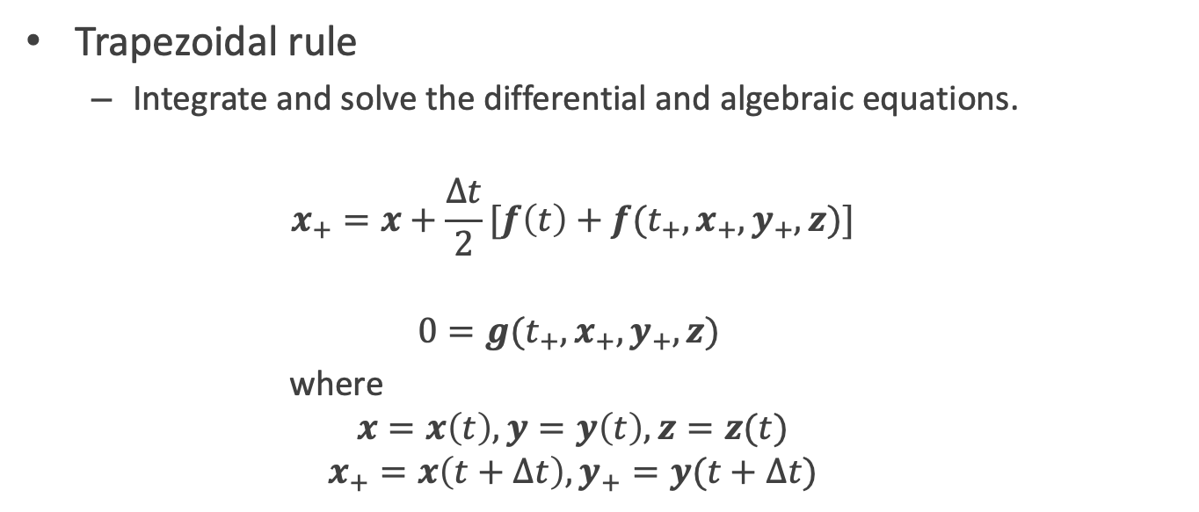
5. Solving the hybrid DAE
Trapezoidal rule
Integrate and solve the differential and algebraic equations.
$$x_{+}=x+\frac{∆t}{2}[f\left(t\right)+f(t_{+},x_{+},y_{+},z)]$$
$$0=g(t_{+},x_{+},y_{+},z)$$
where
$$x=x\left(t\right), y=y\left(t\right), z=z(t)$$
$$x_{+}=x\left(t+∆t\right), y_{+}=y(t+∆t)$$

Slide 14
5. Solving the hybrid DAE
COSMIC implements a variable time-step size
Why?
To trade-off between the diverse time-scales of the dynamics.
During transition periods: small step size → fine resolution.
During steady-state periods: large step size → faster computation.

Slide 15
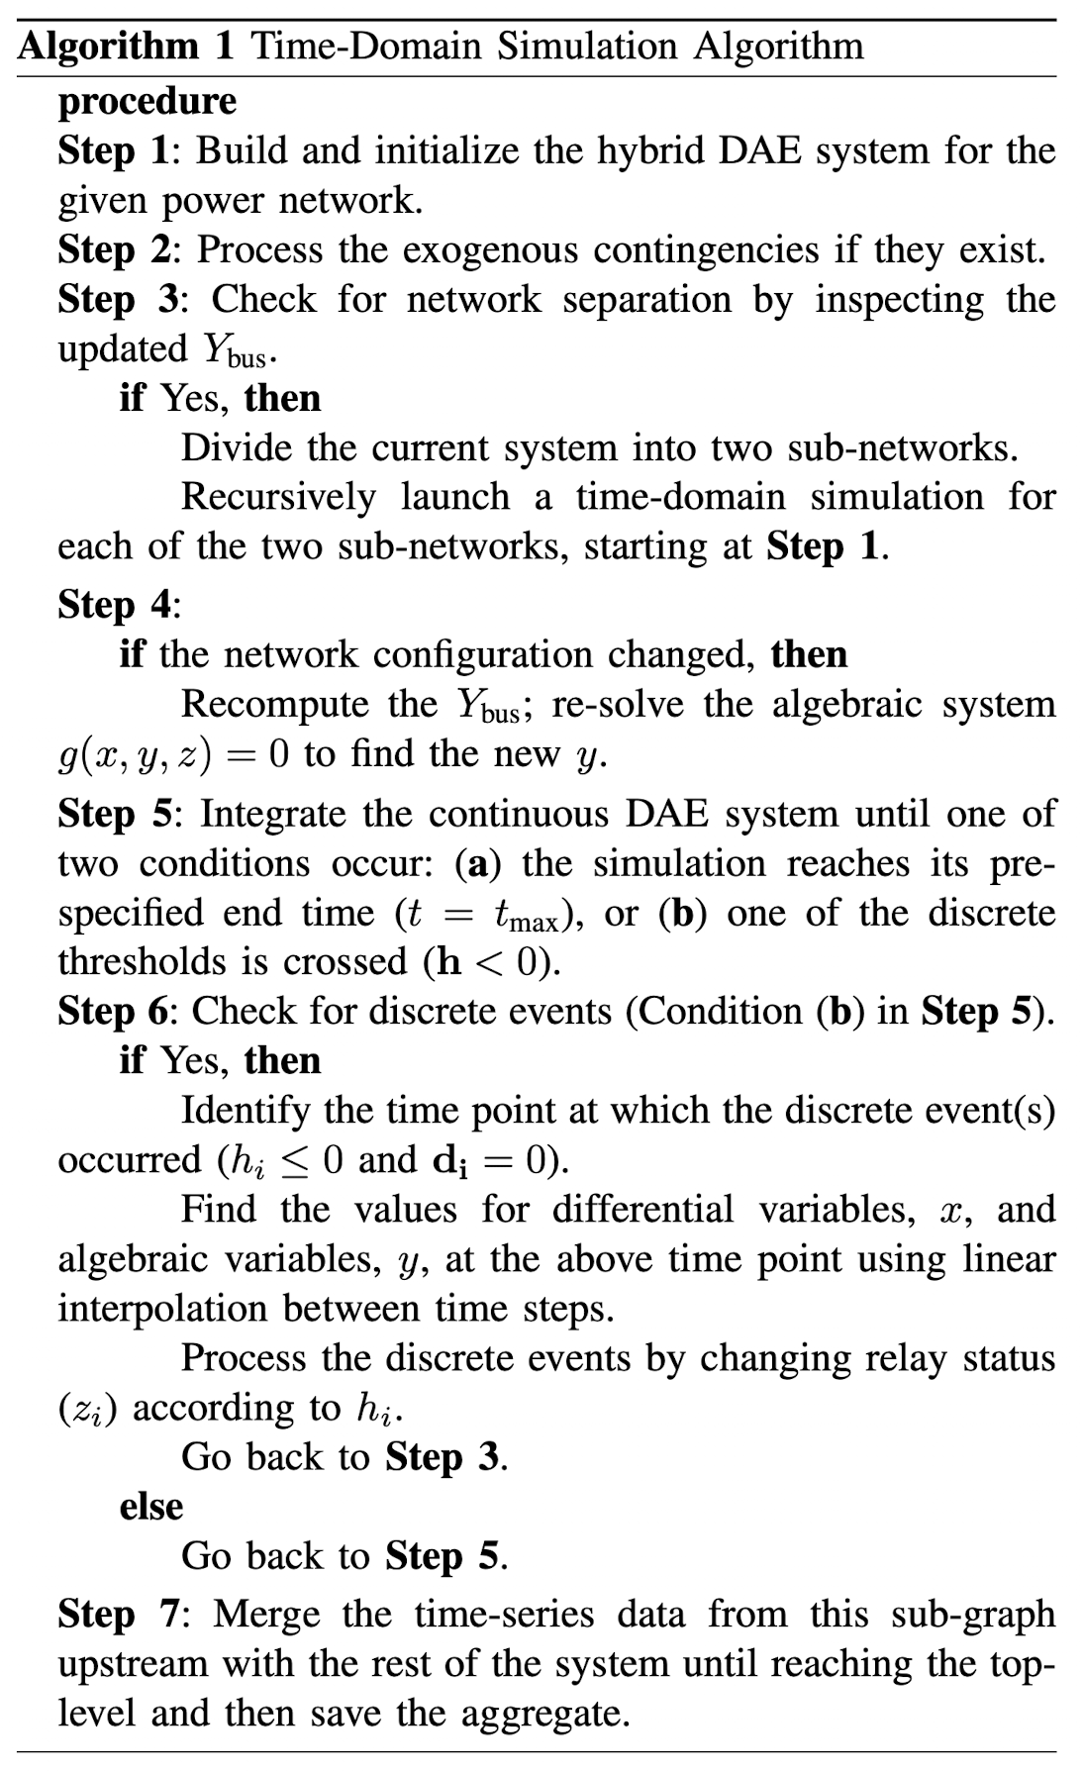
6. Time-domain simulation algorithm

Slide 16
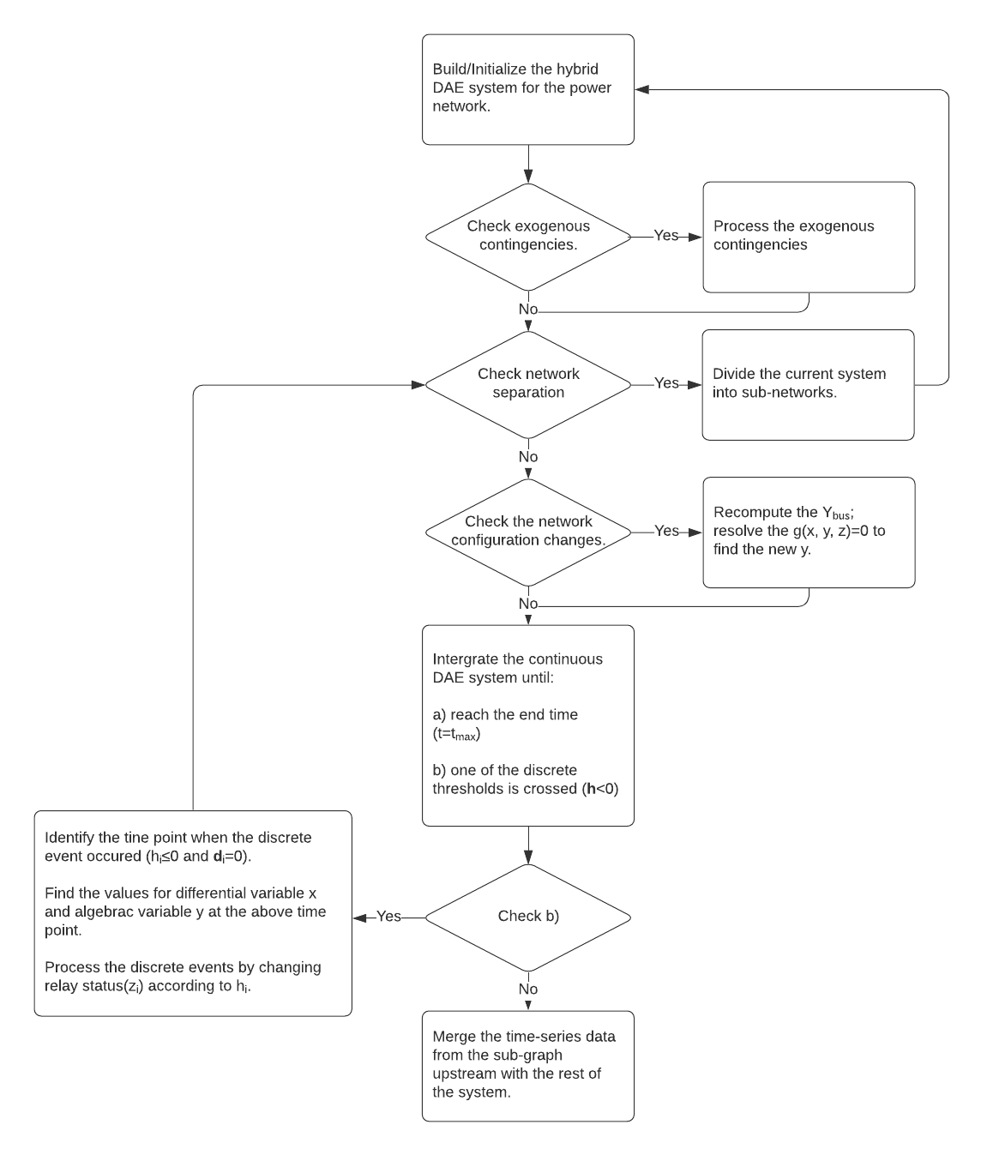
6. Time-domain simulation algorithm - Flowchart

Slide 17
7. Experiments and Results
Polar formulation vs. Rectangular formulation in computational efficiency
Relay event illustration
Cascading outage examples
N-2 contingency analysis
Comparison with a dc cascading outage simulator

Slide 18
7-i. Polar vs. Rectangular in computational efficiency
Purpose
To compare the computational efficiency of the polar and rectangular formulations of the model.
Used test systems
39-bus system
2383-bus system
Notes:
Q. WHY DO WE NEED TO COMPARE THE PERFOMANCE BETWEEN RECT AND POLAR???

Slide 19
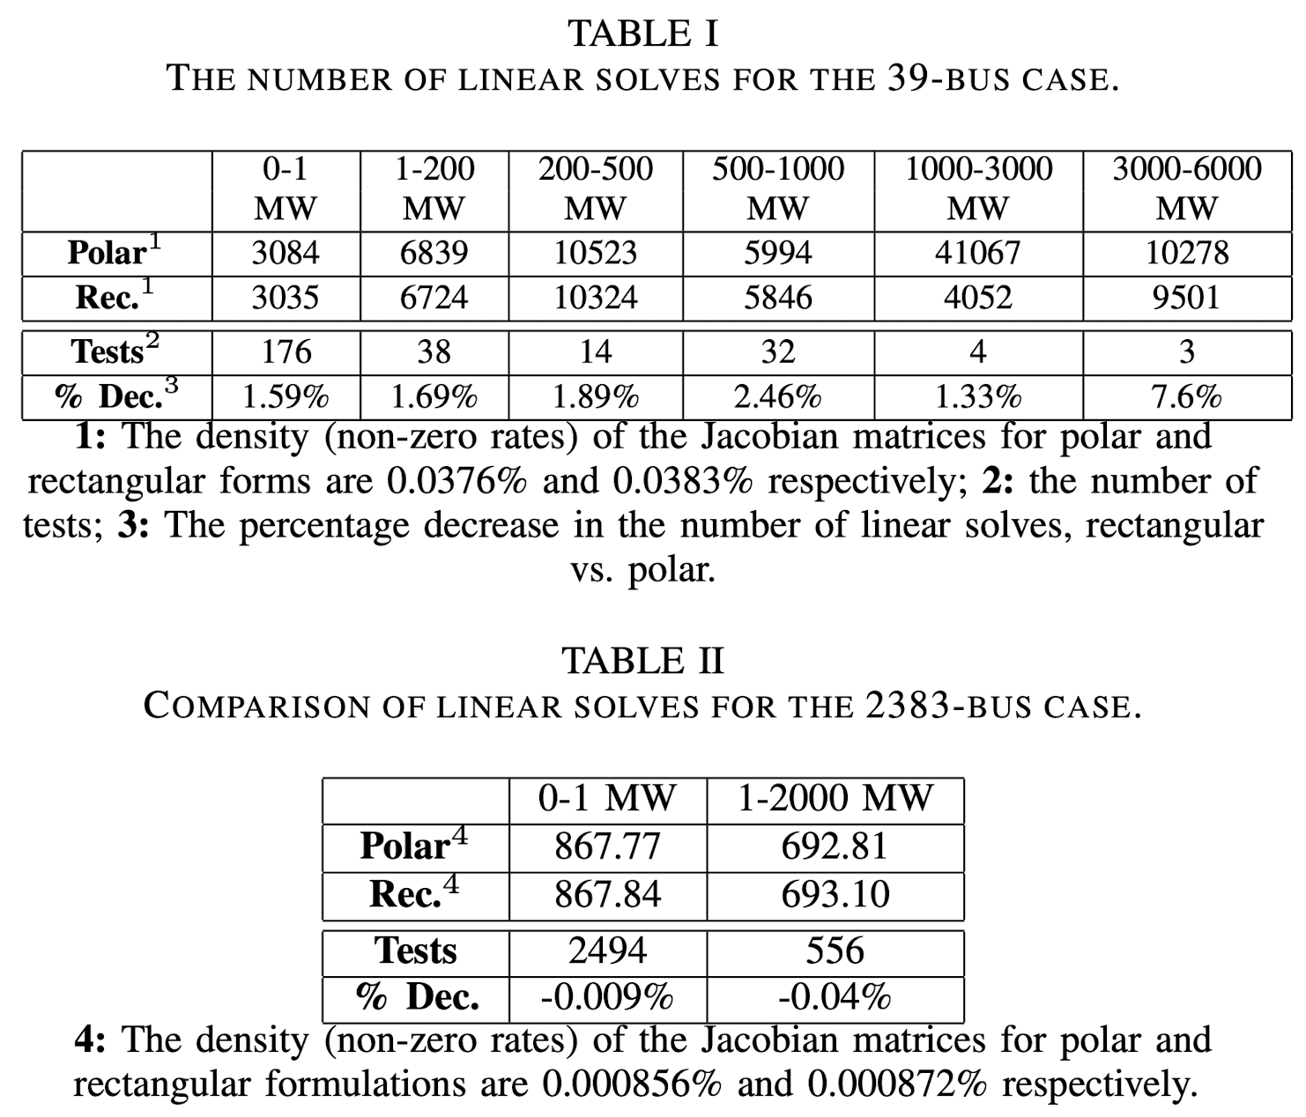
7-i. Polar vs. Rectangular in computational efficiency
Notes:
Q. WHY DO WE NEED TO COMPARE THE PERFOMANCE BETWEEN RECT AND POLAR???

Slide 20
7-i. Polar vs. Rectangular in computational efficiency
Result
On Table I, in 39-bus case, the rectangular formulation required fewer linear solves for different demand losses.
On Table II, in 2383-bus case, there was no significant improvement for the rectangular formulation over the polar formulation, and the number of linear solves that resulted from both forms were almost identical.
Notes:
Q. WHY DO WE NEED TO COMPARE THE PERFOMANCE BETWEEN RECT AND POLAR???
Q. WHY DO WE NEED TO KNOW ABOUT THE DENSITY OF THE JACOBIAN MATRICES???

Slide 21
7-ii. Relay event illustration
Purpose
To illustrate the different relay functions implemented in COSMIC and their time delay algorithms.
Used test systems
9-bus system

Slide 22
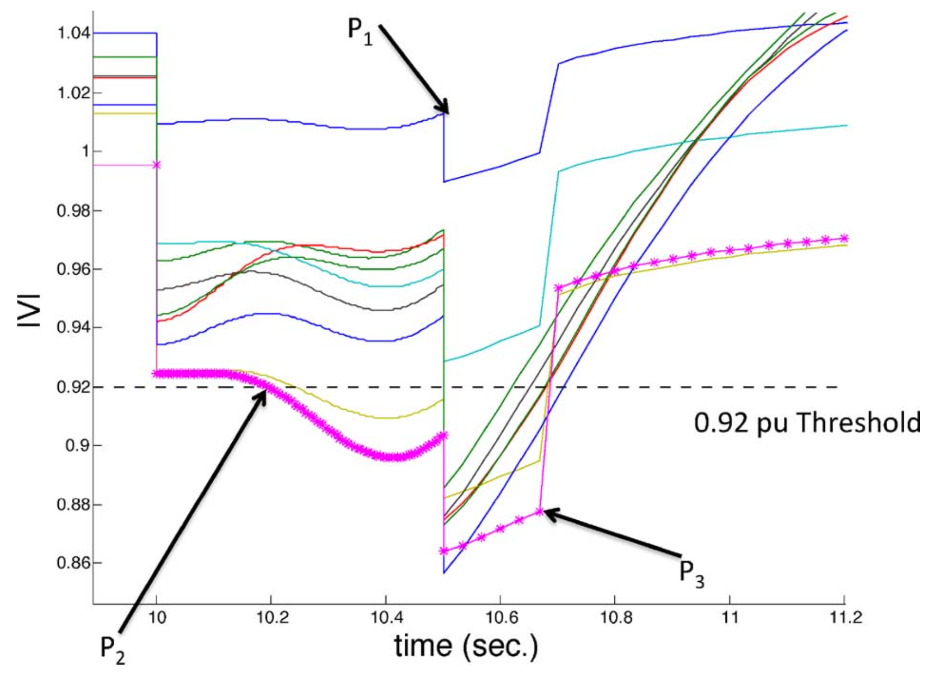
7-ii. Relay event illustration

Slide 23
7-ii. Relay event illustration
Result
A single-line outage was occurred at t=10 seconds, and DIST relay timer activate.
t_{preset−delay}=0.5
P₁(t=10.5): t_{delay} ran out, and another line outage was occurred.
P₂: the magenta voltage trace violated the limit, and UVLS relay timer activate.
P₃: UVLS relay took action and shed 25% of the initial load at the bus.

Slide 24
7-iii. Cascading outage examples
Purpose
To demonstrates how COSMIC processes cascading events such as line branch outages, load shedding, and islanding.
Used test systems
39-bus system
2383-bus system

Slide 25
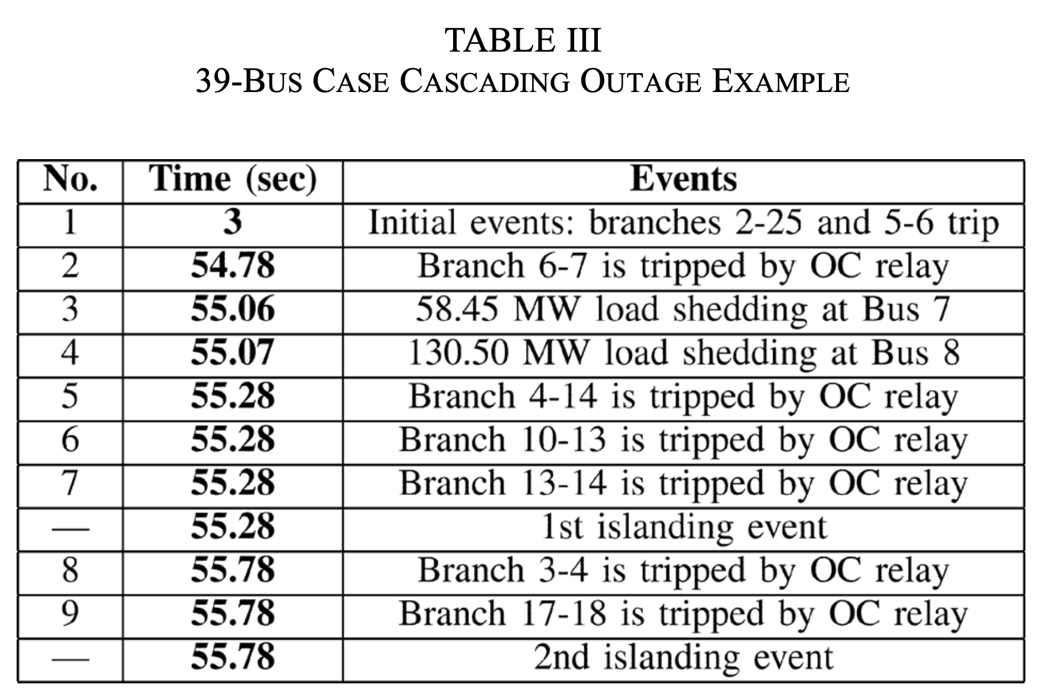
7-iii. Cascading outage examples
39-bus system

Slide 26
7-iii. Cascading outage examples
Result (39-bus system)
At t=3.00 sec, the system suffered a strong dynamic oscillation after the initial two exogenous events (branches 2–25 and 5–6).
At t=54.06 sec, the first OC relay at branch 4–5 triggered.
At t=55.06 and t=55.07 sec, load shedding at two buses (Bus 7 and Bus 8) occurred.
At t=55.28 sec, another two branches (10–13 and 13–14) shut down after OC relay trips. These events separated the system into two islands.
At t=55.78 sec, two branches (3–4 and 17–18) were taken off the grid and this resulted in another island. The system eventually ended up with three isolated networks.

Slide 27
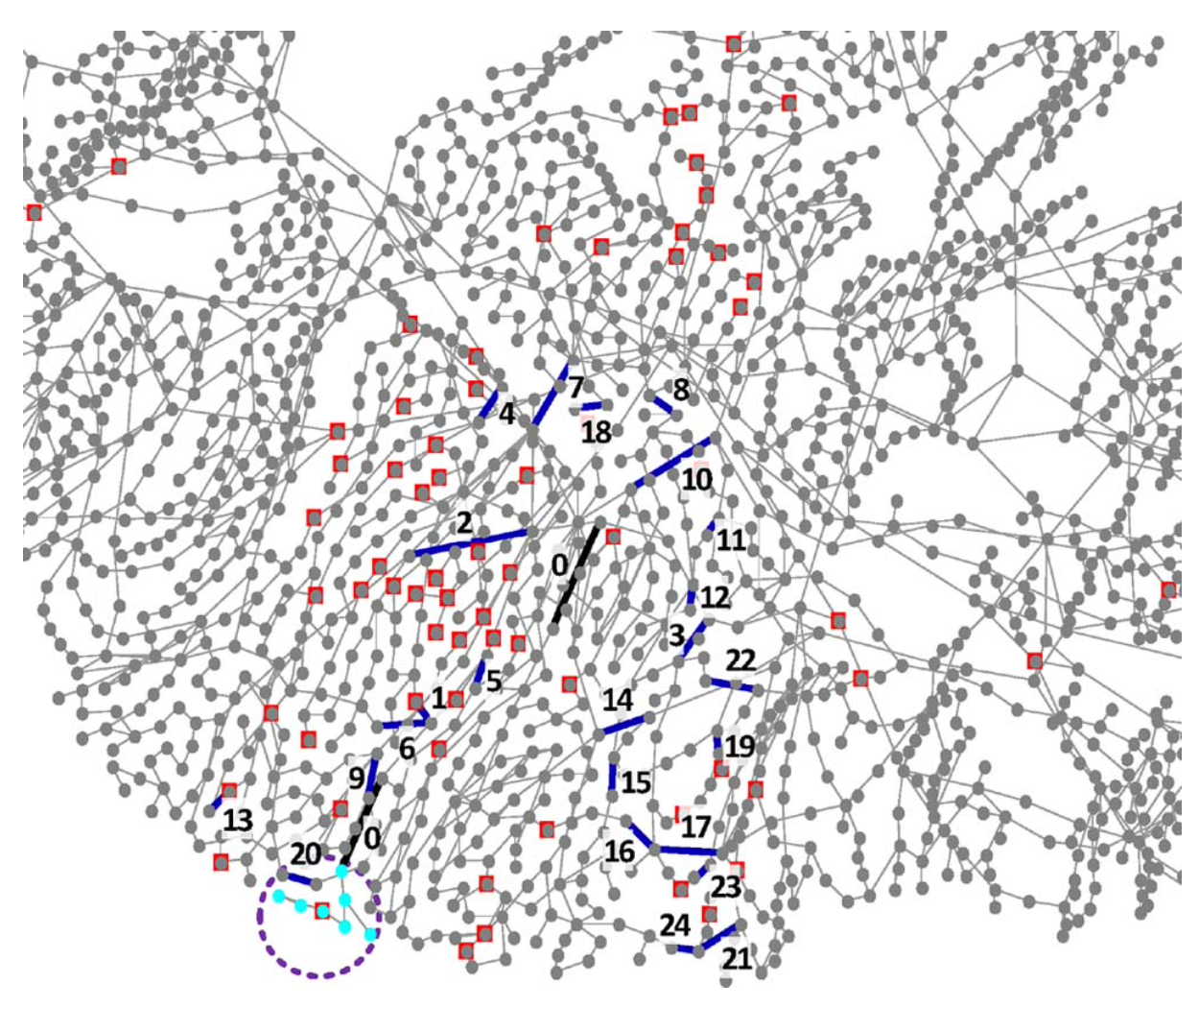
7-iii. Cascading outage examples
2383-bus system
Notes:
Number 0 with black highlights denotes the two initial events (N-2 contingency).
Other sequential numbers indicate the rest of the branch outages.
In this example, 24 branches are off-line and cause a small island (within the dashed circle) in the end.
The dots with additional red squares indicate buses where load shedding happens.

Slide 28
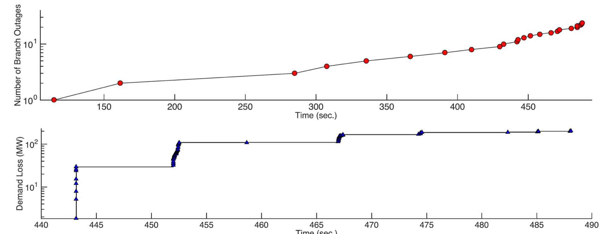
7-iii. Cascading outage examples
2383-bus system

Slide 29
7-iii. Cascading outage examples
Result (2383-bus system)
In the early phase of this cascading outages, the occurrence of the components failed relatively slowly, but it speeds up as the number of failures increased (check top panel).
When the system condition was substantially compromised, fast collapse occurs and the majority of the branch undergo outages as well as the load shedding events (check lower panel).

Slide 30
7-iv. N-2 contingency analysis
Purpose
To studies the impact of different load modeling assumptions on cascading failure sizes.
Used test systems
2383-bus system.

Slide 31
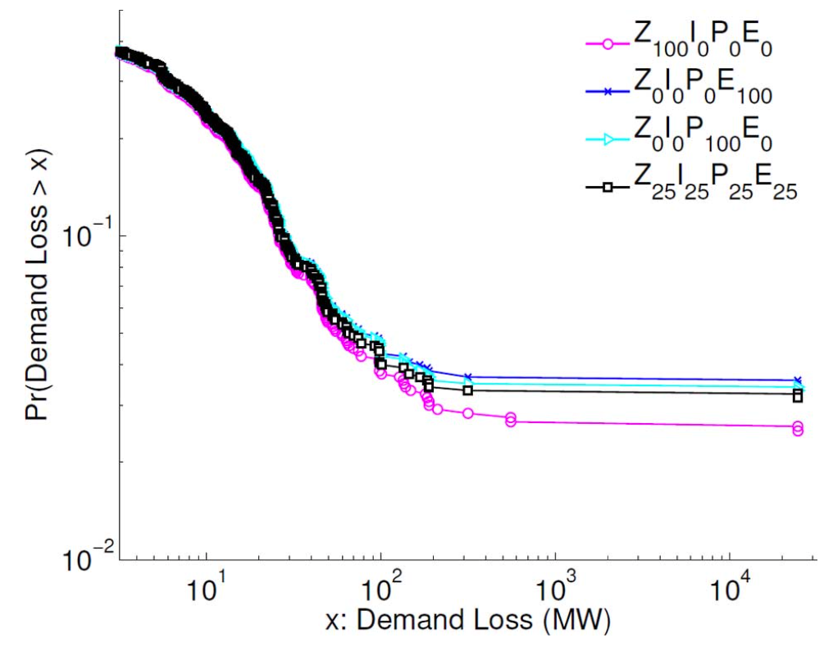
7-iv. N-2 contingency analysis

Slide 32
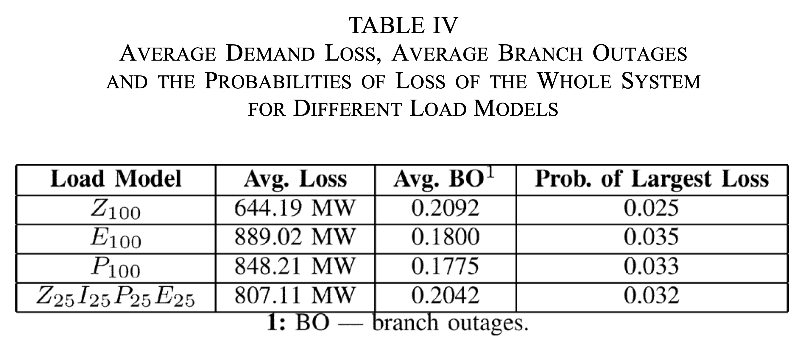
7-iv. N-2 contingency analysis

Slide 33
7-iv. N-2 contingency analysis
Result
The CCDF plots of demand losses exhibit a heavy-tailed blackout size distribution.
As can be seen in Table IV, the probabilities of large demand losses varies.
Load models play an important role in dynamic simulation and may increase the frequency of nonconvergence if they are not properly modeled.
Notes:
Q. WHY A HEAVY-TAILED DIST IS EASILY FOUND IN HISTORICAL DATA AND CASCADING FAILURE MODELS???
Q. WHAT IS THE EXACT MEANDING OF NOT PROPERLY MODELED???

Slide 34
7-v. Comparison with a dc cascading outage simulator
Purpose
To compare results from COSMIC with results from a dc-power flow based model of cascading failure.
Used test systems
2383-bus system.

Slide 35
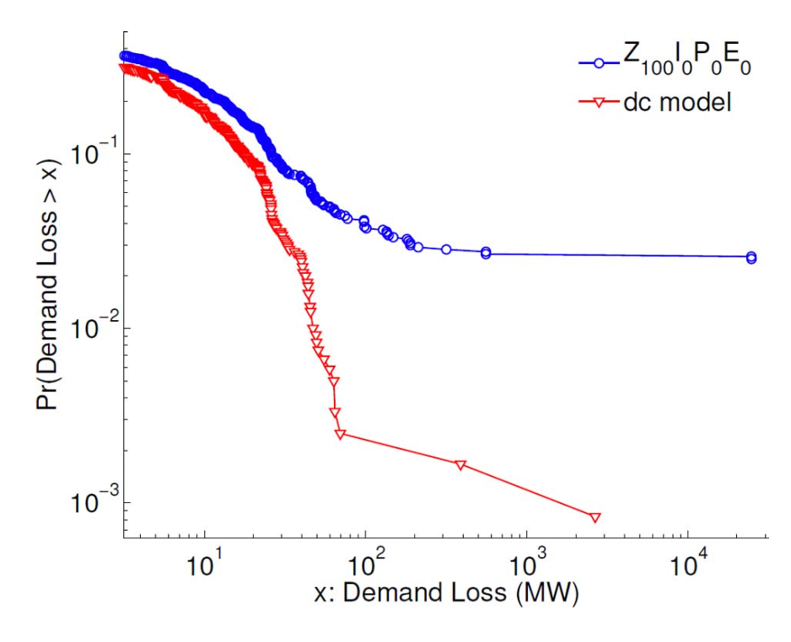
7-v. Comparison with a dc cascading outage simulator
The probabilities of demand loss

Slide 36
7-v. Comparison with a dc cascading outage simulator
Result (probabilities of demand loss)
The probability of demand losses in the dc simulator is lower than that of COSMIC for the same amount of demand losses.
The dc model is much more stable and does not run into problems of numerical nonconvergence.
COSMIC assumes that the network or sub-network in which the numerical failure occurred experienced a complete blackout.
As a result, numerical failures in solving the DAE system greatly contributed to the larger blackout sizes. → It may deteriorate the accuracy.

Slide 37
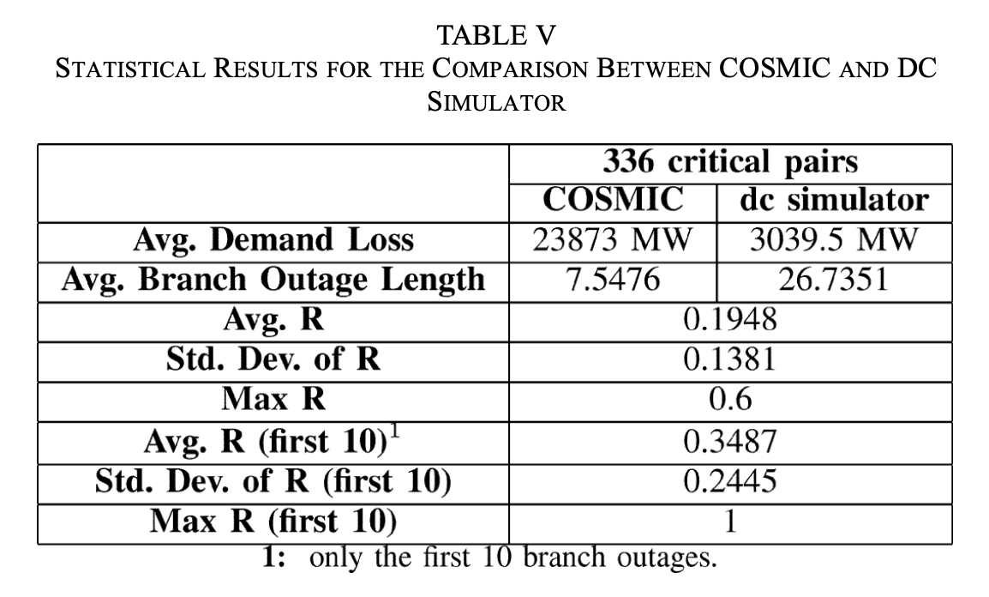
7-v. Comparison with a dc cascading outage simulator
Path agreement measurement (PAM)

Slide 38
7-v. Comparison with a dc cascading outage simulator
Result (PAM)
The average between the two models for the whole set of sequences is 0.1948
When we computed only for first ten branch outage event, the average R increased to 0.3487, and some of the cascading paths showed a perfect match (R=1).
The cascading paths resulting from the two models tend to agree during the early stages of cascading.
Notes:
Q. WHY DC MODEL TENDS TO PRODEUCE LONGER SCENARIOS???

Slide 39
My Research Project
Purpose / Goal
Forecast or detect (in real-time) cascading outages in power systems.
Approach
Use a GNN based model to predict or detect cascading outages.

Slide 40
My Research Project
Experiments
Data generation
Design the GNN based model architecture
Train & Test the model
Tune the hyper-parameters of the model

Slide 41
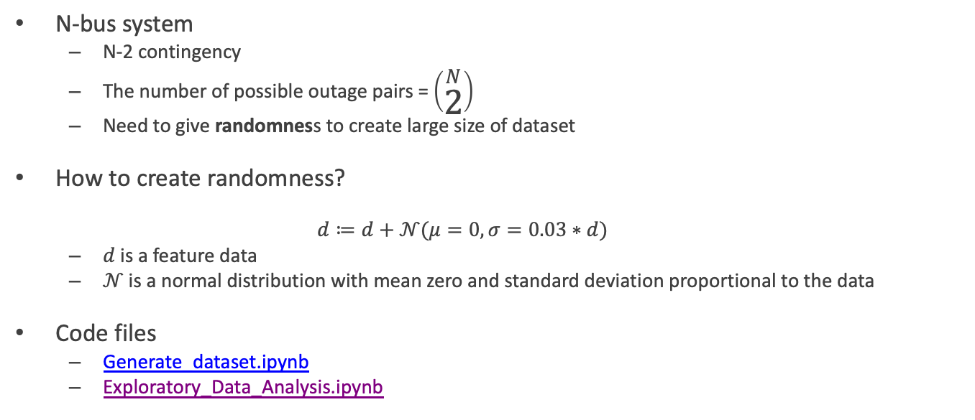
i. Data generation
N-bus system
N-2 contingency
The number of possible outage pairs = $\left(\begin{aligned}N \\ 2\end{aligned}\right)$
Need to give randomness to create large size of dataset
How to create randomness?
$$d≔d+𝒩(μ=0, σ=0.03∗d)$$
$d$ is a feature data
$𝒩$ is a normal distribution with mean zero and standard deviation proportional to the data
Code files
Generate_dataset.ipynb
Exploratory_Data_Analysis.ipynb
Notes:
Q. WHICH FEATURES (e.g. Pd,Qd,Pg,Qg or outage event time tevent) SHOULD BE GIVEN RANDOMNESS?

Slide 42
ii. Design the GNN based model architecture
Does the model ARCHITECTURE is proper for the GOAL?
WHY?
What is the STRENGTH of the model ARCHITECTURE?
WHY?

Slide 43
iii. Train & Test the model

Slide 44
iv. Tune the hyper-parameters of the model

Slide 45
Results (What we want to see…)
High enough prediction or detection accuracy.
Extremely high computational efficiency compared to old methods.
A GNN based model having significantly fewer nodes (trainable parameters) than other deep learning models.

Slide 46
Reference
[1] J. Song, E. Cotilla-Sanchez, G. Ghanavati and P. D. H. Hines, “Dynamic Modeling of Cascading Failure in Power Systems,” in IEEE Transactions on Power Systems, vol. 31, no. 3, pp. 2085-2095, May 2016.
[2] M. Papic et al., “Survey of tools for risk assessment of cascading out- ages,” in Proc. IEEE Power and Energy Soc. General Meeting, 2011, pp. 1–9.
[3] M. Vaiman et al., “Risk assessment of cascading outages: method- ologies and challenges,” IEEE Trans. Power Syst., vol. 27, no. 2, pp. 631–641, May 2012.
[4] I. Dobson, B. A. Carreras, V. E. Lynch, and D. E. Newman, “Com- plex systems analysis of series of blackouts: cascading failure, critical points, and self-organization,” Chaos: Interdisciplinary J. Nonlinear Sci., vol. 17, no. 2, p. 026103, 2007.
[5] M. Eppstein and P. Hines, “A ‘random chemistry’ algorithm for iden- tifying collections of multiple contingencies that initiate cascading failure,” IEEE Trans. Power Syst., vol. 27, no. 3, pp. 1698–1705, Aug. 2012.
[6] “Trapezoidal Rule,” Math24, 30-Apr-2020. [Online]. Available: https://www.math24.net/trapezoidal-rule/. [Accessed: 07-Jan-2021].
[7] P. Hines, J. Apt, and S. Talukdar, “Large blackouts in North America: historical trends and policy implications,” Energy Policy, vol. 37, no. 12, pp. 5249–5259, 2009.
[8] B. A. Carreras, D. E. Newman, I. Dobson, and N. S. Degala, “Val- idating OPA with WECC data,” in 2013 46th Hawaii Int. Conf. on System Sciences (HICSS), Jan. 2013, pp. 2197–2204.
[9] D. Deka and S. Misra, “Learning for DC-OPF: Classifying active sets using neural nets,” 2019 IEEE Milan PowerTech, Milan, Italy, 2019, pp. 1-6.

